Slide 1
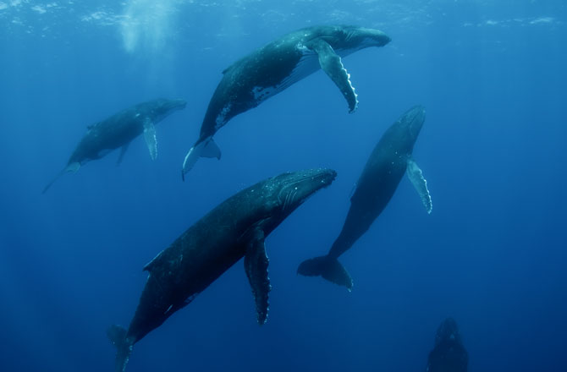
Whales

Slide 2
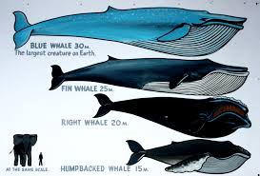
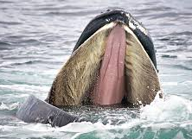
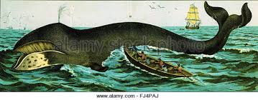
Baleen Whales
Toothless
Have flexible keratin plates called baleen
Used to filter feed
Largest animals on earth
Range in size from 29-89ft
13 species
Used to be common but were overhunted

Slide 3
Types of Baleen Whales

Slide 4
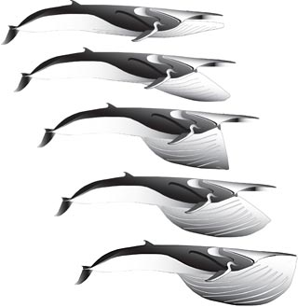
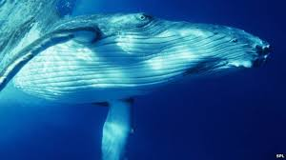
Rorquals
Baleen whales with grooves on their undersides
Feed by gulping up schools of fish and swarms of krill
Lower anterior portion of the body expands
Use bubbles to herd fish

Slide 5
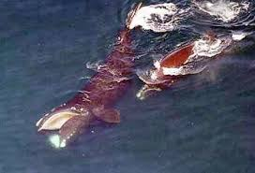
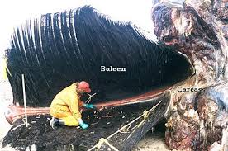
Right & Bowhead Whales
Swim along surface open mouthed
Have largest plates & finest bristles

Slide 6
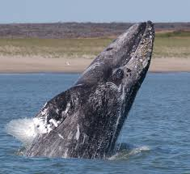
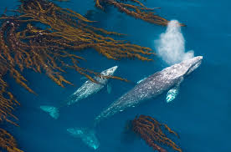
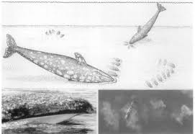
Gray Whales
Bottom feeders
Filter sediment for crustaceans
*odd fact: mostly right “handed” feeders*

Slide 7
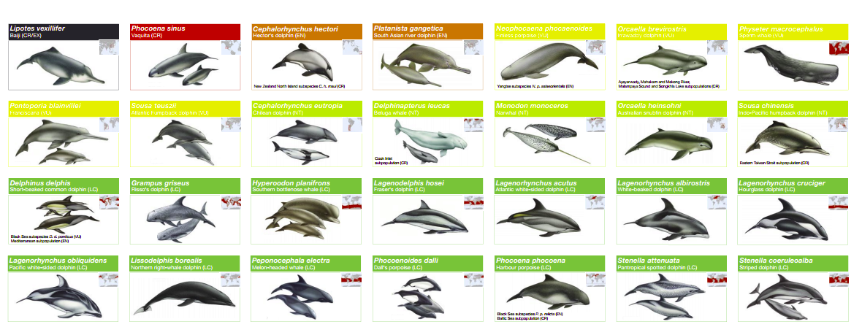
Toothed Whales
80 species ranging in size from 4.5-59ft
Includes dolphins and porpoises

Slide 8
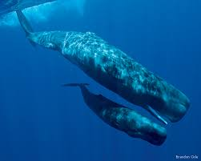
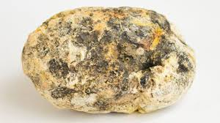
Sperm Whales
Considered a Great Whale
More closely related to baleen whales than toothed whales
*fun fact: the undigested squid beaks form sticky globs in their stomachs known as ambergris which is used in fine perfumes!*

Slide 9
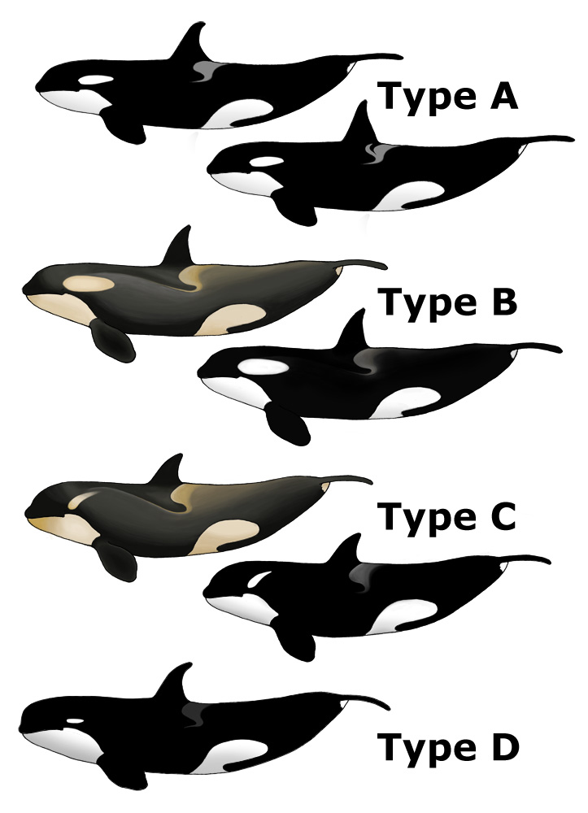
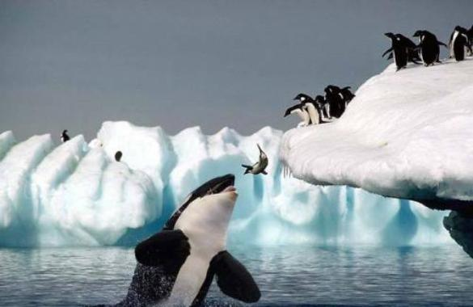
Orcas
3 distinct species with distinct appearance, hunting, diet, and even dialect

Slide 10
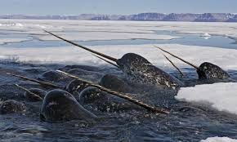
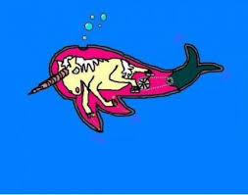
Narwhals
Males have a large tusk or tooth
Appears to be related to the hierarchy of dominance
Contain fluid filled tubes that connect to the nervous system
*fun fact: tusks that washed ashore gave rise to the myth of the unicorn!*

Slide 11
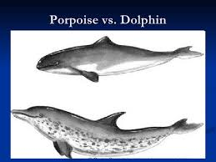
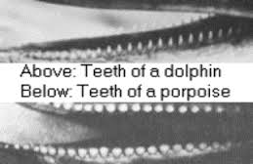
Dolphins & Porpoises
Still whales!
Porpoises have a blunt nose and flat teeth
Dolphins have a distinct snout or beak (and smile!) with cone shaped teeth

Slide 12
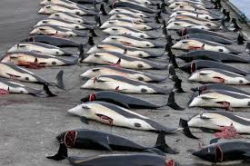
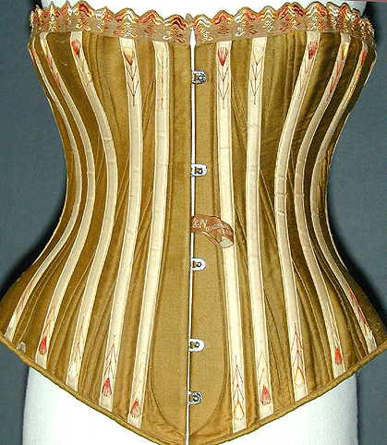
Whaling
Whale hunting
Exploitation began in the 1600s
Blubber was used for soap & lamp oil
Baleen used for corset stays
Food product
Almost all great whales are threatened or endangered
Hunted until their fisheries collapsed then moved to a new species

Slide 13
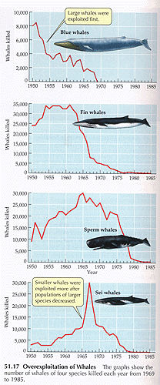
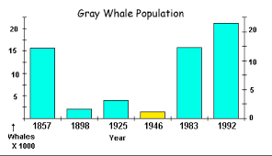
Why is this a Problem?
Whales have a long life & produce few young
Populations can’t bounce back when only 1 offspring is produced every 2-3 years

Slide 14
International Whaling Commission (IWC)
Formed in 1946 between 20 countries in an attempt to regulate whaling
Declared a moratorium on all hunting in 1985 but Japan found a loophole…”scientific hunting”
Ineffective at protecting whales
Too little, too late…

Slide 15
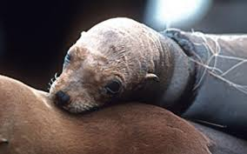
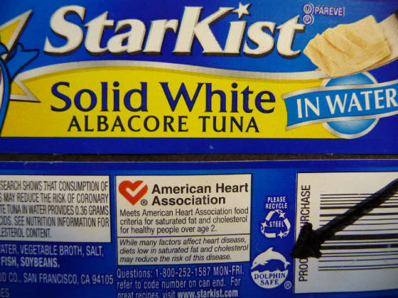
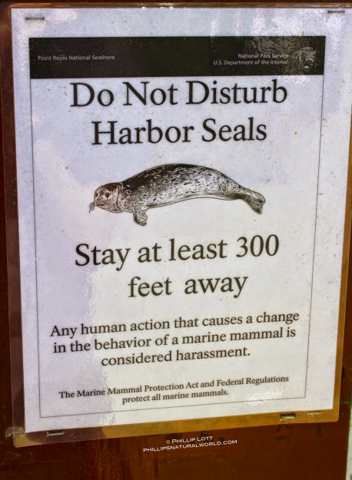
Marine Mammal Protection Act (1972)
Banned the hunting of all marine mammals in US waters & the importation of marine mammal products

