Slide 1
Welcome to Marine Science
Mrs. Wilson
rwilson2@sandi.net
wilsonmarinescience.weebly.com
Room 441
858-457-3040 x127

Slide 2
About Me: Education and Work Experience
B.S. Biological Science (The University of Arizona)
Masters in Educational Leadership (San Diego State University)
Worked as a chemist for 8 years.

Slide 3
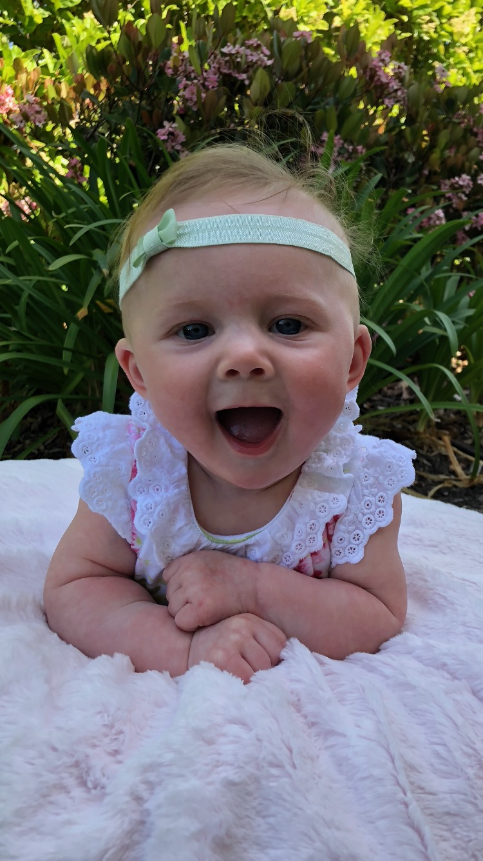
About Me: For Fun!
New Mom ☺
From Oregon
Like to bike (Mountain and Road)
Have 1 Cat (Chunk)
Love science!
Hobbies (Traveling, camping, and reading)

Slide 4
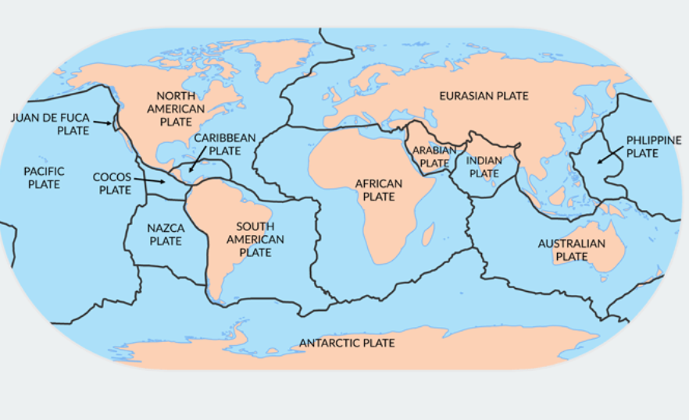
Marine Science (First Semester)
Geological Oceanography
Chemical Oceanography
Physical Oceanography

Slide 5
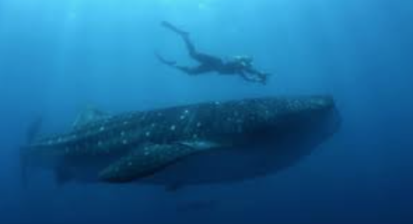
Marine Science (Second Semester)
Biological Oceanography/Marine Biology
Human Impacts on Marine Organisms

Slide 6
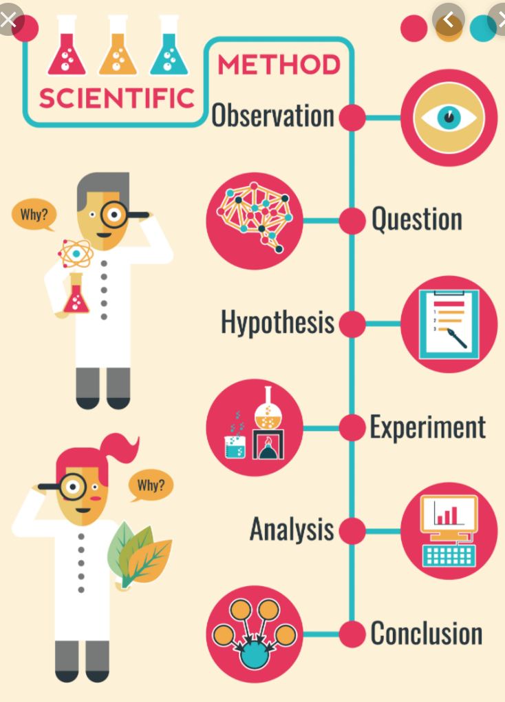
First Semester Intro Unit
Scientific Method
Experimental Design
Chemicals negatively impacting marine life
Measurement
Density
Graphing
World Map
Marine Science Fields
History of Marine Science

Slide 7
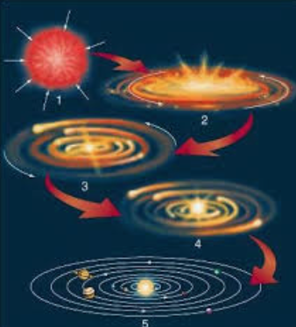
First Semester Units Cont.
Universe, Solar System, and Earth Formation
Plate Tectonics, Earthquakes, and Tsunamis
Bathymetry and Ocean Floor Features
Weather, Wind, and Ocean Currents
Waves and Tides

Slide 8
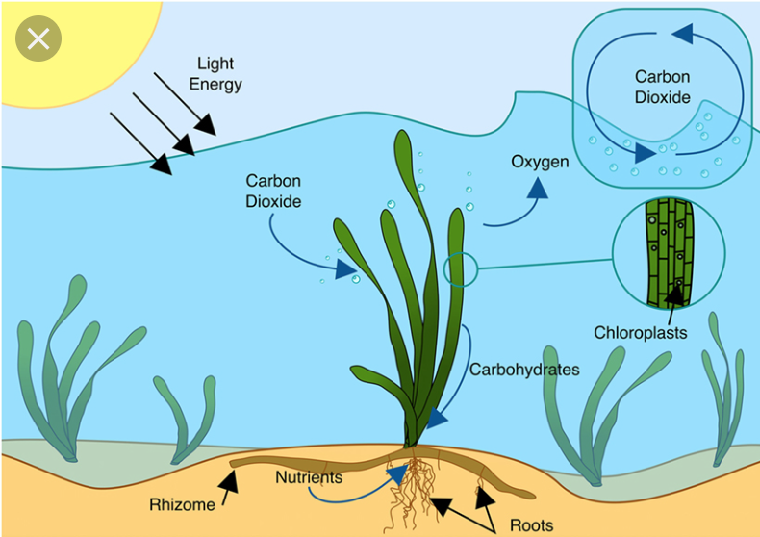
Second Semester Intro Unit
Cells, Photosynthesis, and Cellular Respiration
Marine Ecology
Taxonomy
Global Warming
Ocean Plastic

Slide 9
Second Semester Units Cont.
Estuary and Intertidal Organisms
Algae and Kelp Coral ReefsSea and Shore Birds
Deep Sea Organisms
Jawless, Bony, and Cartilage Fish
Marine Mammals
Human impacts on each group.

Slide 10
Course Goals
For the students to:
Be well rounded and thoughtful problem solvers/scientists.
Use the natural appeal of the ocean to further their ocean literacy.
Have awareness of the issues that confronts the oceans well being and ultimately awaken a sense of stewardship for this resource.

Slide 11
Teacher Office Hours
Early out intervention days
By appointment:
During lunch
After school

Slide 12
Grades
Grades will be posted regularly online (PowerSchool)
Class schedule and most assignments are available on my website.
Class percentage is calculated as follows:
Performance Tasks (Projects, labs, and writings) = 30%
Activities (Journal and Activities/Packet) = 30%
Assessments (Quizzes, Unit Exams, and Final) = 40%

Slide 13
Class Expectations
Check board/Website for daily schedule.
Each Day:
Bring warm-up journal and unit items.
Be prepared to work on labs, projects, writings, and/or activities.
If absent, check schedule online for missed assignments. Hard copies available in class.
Check Power School for grade updates.
Turn in assignments on time for full credit!
Be sure assignment is accurate and complete before submitting.
Turn in all late assignments before the end of each grading period.

