Slide 1
Unique Properties of Water
Properties affected by hydrogen bonds:
Density of water
Boiling & freezing point
Surface tension (highest of any liquid)
Capillary Action
Dissolving abilities (dissolves more substances than any other liquid)

Slide 2
Density of Water
Liquid water density is:
1 gram/ml
Liquid water density increases as it cools . . . max at 39.16°F or 3.98ºC
Liquid water density decreases as it warms.
This allows water to form layers in the ocean.
Empty space

Slide 3
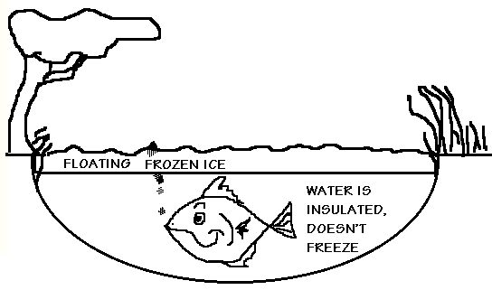
Density
Floating ice insulates water below, preventing freezing: critical for ocean animals.

Slide 4
Freezing Water
Informational! Do not write!
The space taken up by 27 water molecules in liquid water is now only occupied by 24 in ice.
The angle between the hydrogen atoms increases to 109° causing water to expand in volume by 9%
The density of ice is 0.917 g/cm³ at 0°

Slide 5
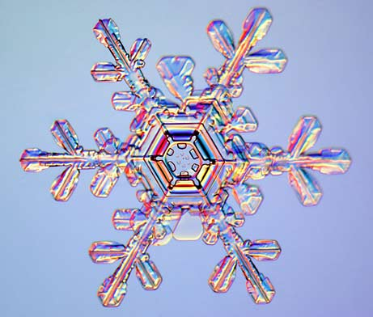
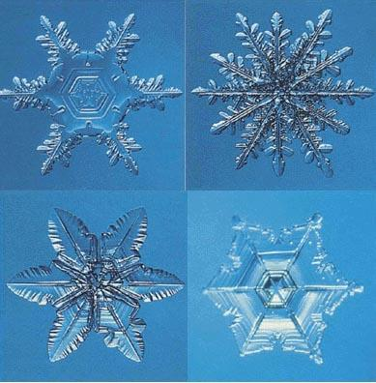
Freezing Water
Ice has a geometric pattern that is six-sided. This pattern is called a lattice. This produces the beautiful patterns in snowflakes.

Slide 6
Boiling Point and Freezing Point
Substance | Formula Mass, g | Melting Point, °C | Boiling Point, °C
Water, H₂O | 18.02 | 0 | 100
Ammonia, NH₃ | 17.04 | -77.7 | -33.35
Methane, CH₄ | 16.05 | -182.5 | -161.49
Methanol, CH₃OH | 32.04 | -97.8 | 64.96
Ethanol, C₂H₅OH | 46.08 | -117.3 | 78.5
Sulfur dioxide, SO₂ | 64.07 | -72.7 | -10
Carbon dioxide, CO₂ | 44.01 | -56.6 @5.2 atm | -78.5 sublimes
Source: CRC Handbook of Chemistry and Physics

Slide 7
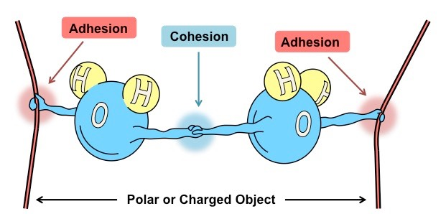
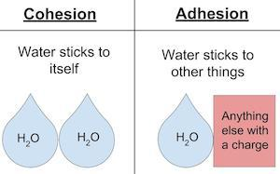
Cohesion & adhesion of water molecules
Water sticks to things that have a charge, that’s adhesion.
Water sticks to other water molecules because they are polar, that’s cohesion.

Slide 8
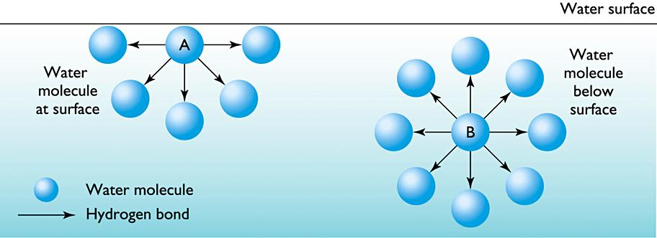
Surface Tension
Surface tension is described as:
Cohesion between water molecules form a skin-like surface.
Molecules must overcome this surface to evaporate.
Surface tension allows water to form drops.
Surface tension allows for the formation of waves in the ocean.

Slide 9
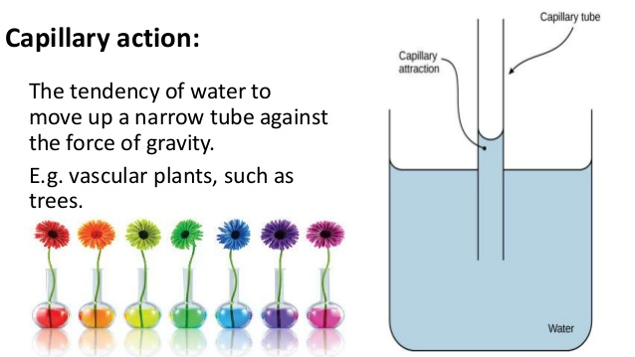
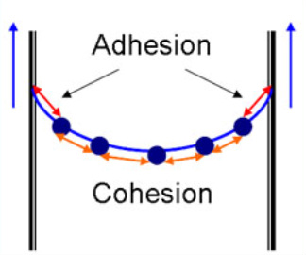
Capillary action occurs when water molecules “tow” each other along (seeming to defy gravity) when in a thin tube.
Water has the ability to climb structures due to adhesion.

Slide 10
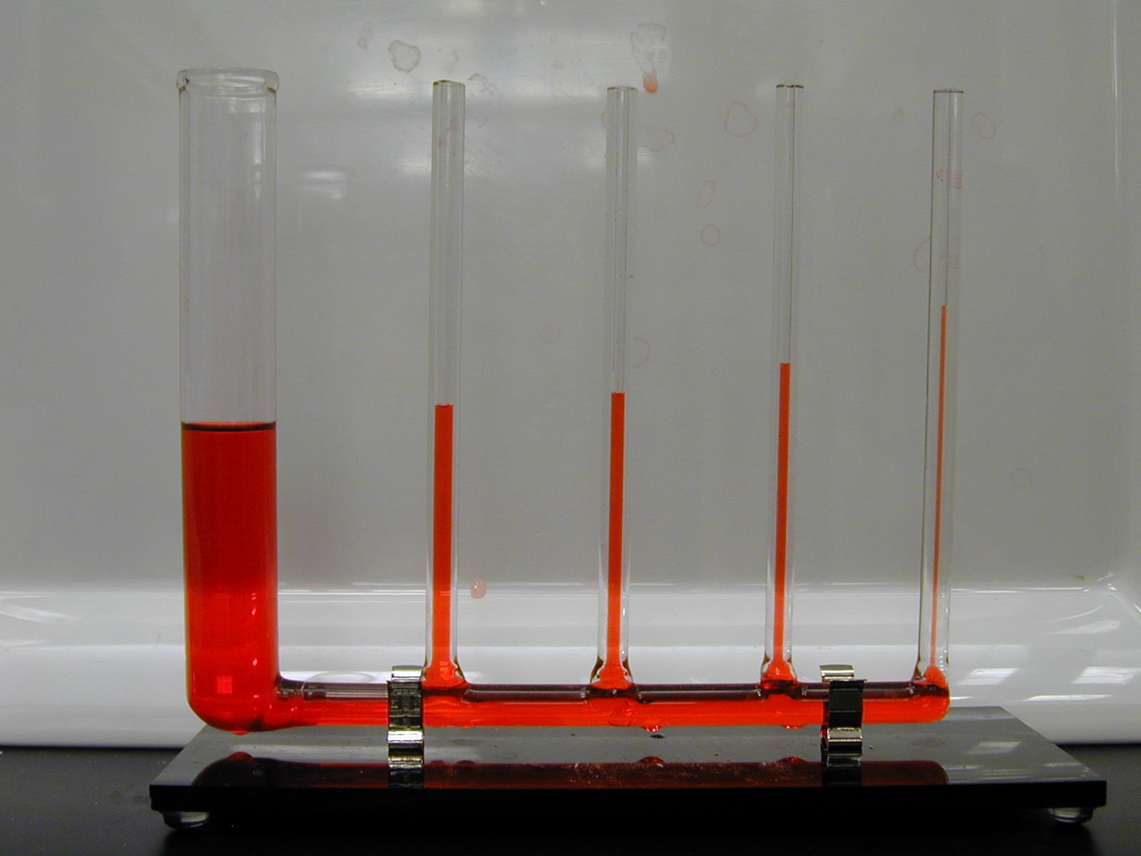

Slide 11
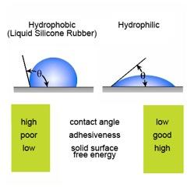
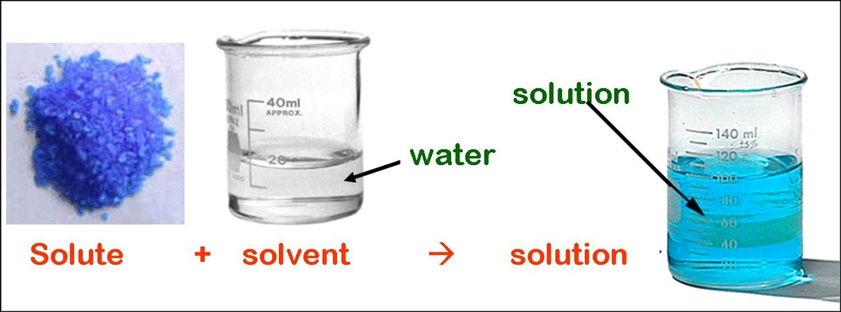
Water: the Universal Solvent
Water is called the “universal solvent” because it dissolves more substances than any other liquid.
Solvent - the liquid in which a solid dissolves
Solute - the molecule dissolved in the solvent
Hydrophobic - a substance that repels (afraid of) water. Non-polar molecule. Example: oil
Hydrophilic - a substance that is attracted to water. A polar molecule. Example: sugar, salt

Slide 12
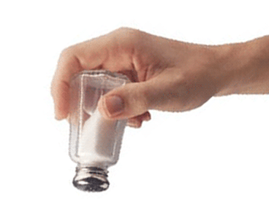
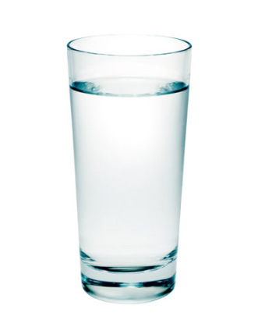
Water Dissolving a Polar Substance: Salt
What happens when you add these two substances together?
On a molecular level, does the salt disappear?
From what you know about the water molecule and its properties, what happens to salt?
NaCl
H₂O

Slide 13
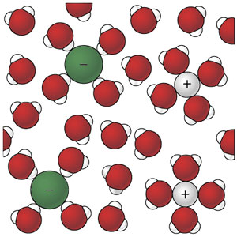
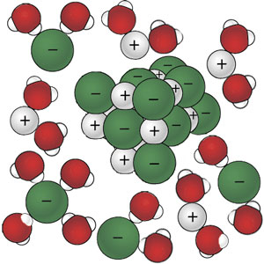
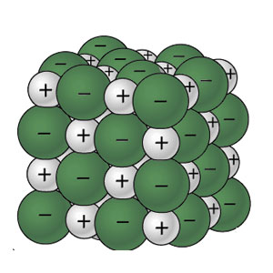
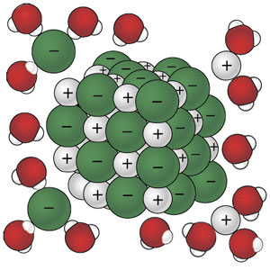
Water Dissolving a Polar Substance: Salt
Salt added to water:
Water molecules have a negative oxygen end (red) and a positive hydrogen end (white). Since water is a polar molecule it begins to “rip” apart the salt crystal.
A salt crystal: a compound made of a sodium ion bonded to a chlorine ion.
The sodium is a positive ion (gray +)
The chlorine is a negative ion (green -)
Salt added to water:
Water molecules have a negative oxygen end (red) and a positive hydrogen end (white). Since water is a polar molecule it begins to “rip” apart the salt crystal.
Water Dissolves Salt:
Water molecules have separated the sodium & chloride ions. Since matter is conserved the ions are now part of the solution, which is salt water.

