Slide 1
Models of life

Slide 2
Models
Models can represent ideas, concepts, objects, processes, or systems that are otherwise difficult to observe directly.
They are used to help explain and make predictions
But are not complete representations - there are limits to what models can show.

Slide 3
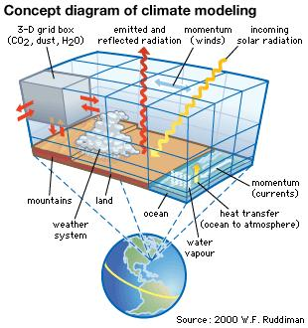
Types of Models
Mathematical
Graphs
Conceptual
Represent concepts (See right)
Physical
3-D models

Slide 4
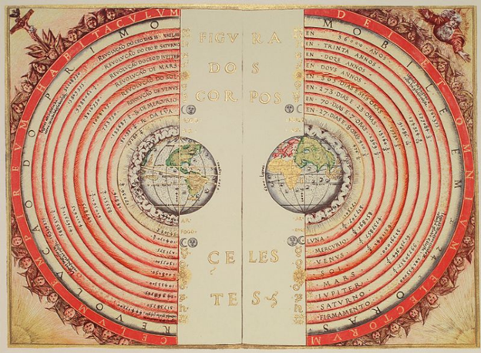
Models can change - as new research is performed, more accurate information is used. model-making
A 16th century model showing a geocentric view of our solar system - where all bodies were believed to revolve around the Earth.
Notes:
By Bartolomeu Velho - Own work, Public Domain, https://commons.wikimedia.org/w/index.php?curid=3672259
Work and observations by Copernicus, Kepler, and Galileo allowed us to realize that this geocentric model was incorrect.

Slide 5
Models: Strengths & Weaknesses

Slide 6
Mathematical Model
Strengths?
Weaknesses?
Shows change over time
Easily identify variables in experiment
May not show why something is occurring.
Less tangible than other models because equations and data are used to represent a concept.

Slide 7
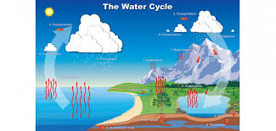
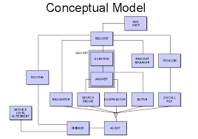
Conceptual Model - Graphic Organizer or Diagram/Cycle
Strengths?
Weaknesses?
Notes:
Strengths: Shows relationships between things; can categorize; visual; organized; shows cause and effect
Weaknesses: Can become overwhelming (graphic organizer/concept map) if there are lots of things/terms;

Slide 8
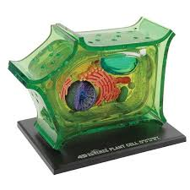
Physical Model
Strengths?
Weaknesses?
Notes:
Strengths: makes things easy to see (especially when it’s a model of something very tiny); tangible
Weaknesses: time consuming/expensive to make; parts are not labeled; may not always show mechanisms; hard to show a process

Slide 9
Create a model (poster)
Pick two organisms - one plant one animal
Create a model (one on each side of paper) showing how it satisfies each of the characteristics of life
At least one model needs to have visuals

Slide 10
