Slide 1
Assigned Chemical Pollutant (List here)
Team Member Names (First and Last)
Period

Slide 2
How Chemical Pollutant Is Entering Ocean

Slide 3
How Chemical Pollutant Is Affecting Plants and/or Animals

Slide 4
Materials and Equipment Needed During Lab

Slide 5
Safety Hazards

Slide 6
Experimental Variables
Test Subjects =
Test Group =
Control Group
Independent Variable =
Dependent Variable =

Slide 7
Why experiment is controlled (Describe the reason it’s controlled and list the variables that are similar and different)

Slide 8
Step-by-Step Procedure (Use as many slides as you need for this part)

Slide 9
Data Collected
Quantitative Data:
Qualitative Data

Slide 10
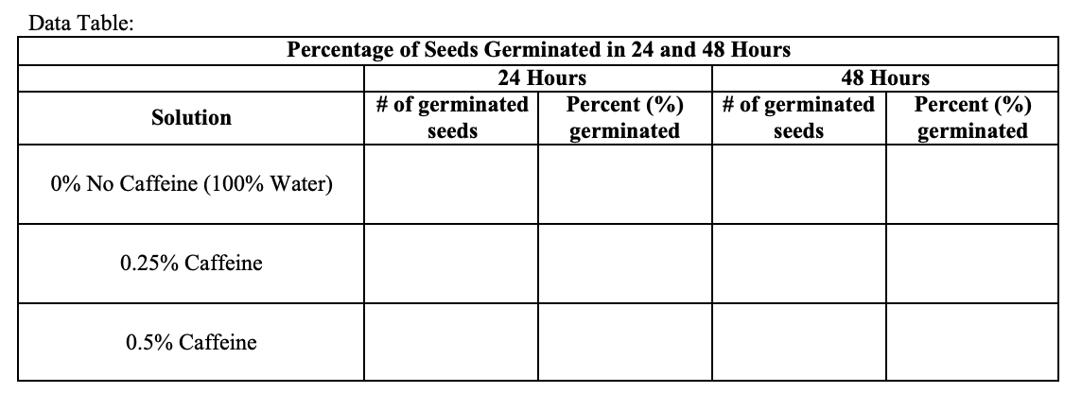
Data Table Create a data table below that will be filled in during the experiment Example provided below

Slide 11
Graph Take a screen shot of the type of graph to be plotted after data collection and then identify the titles below: Main Title = Y-Axis Title = X-Axis Title =

Slide 12
Graph Template (Include Below)

