Slide 1
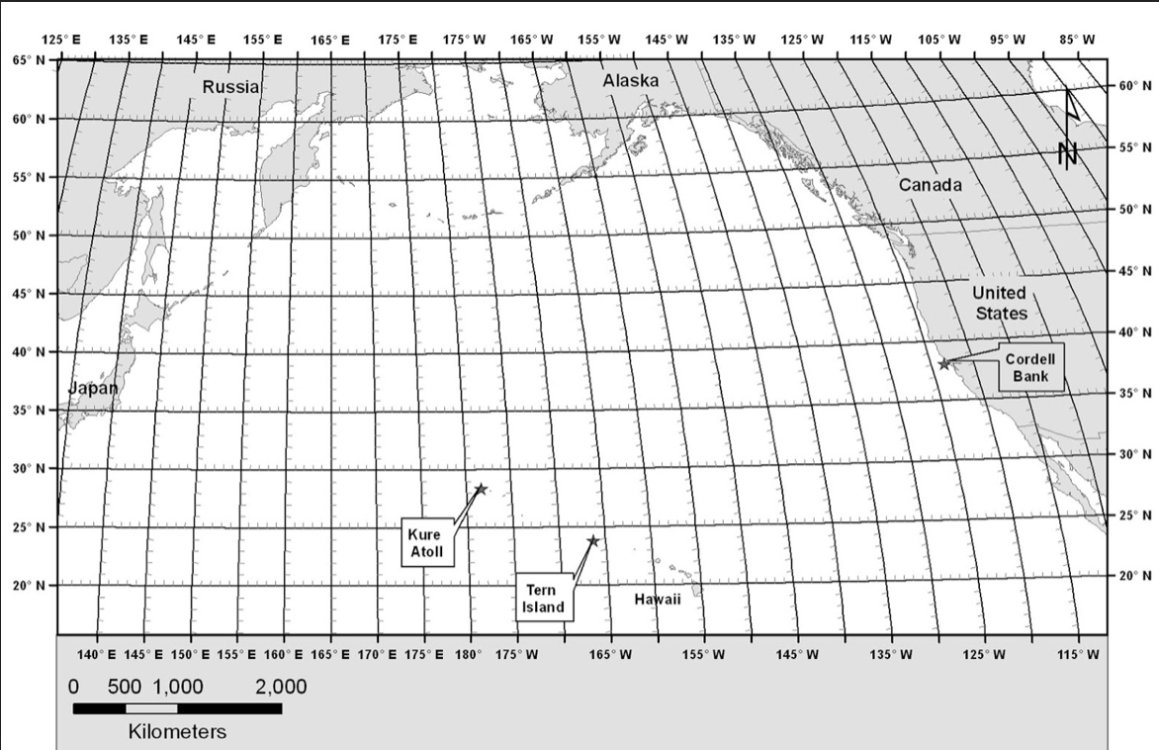
Use numbers to plot your points in sequential order!

