Slide 1
5-7-18 Warm-up Directions
Take Cornell notes in your lab journal on slides #2 – 8. Turn the title into a question and summarize the information on each slide on the left. The more information you have, the more you can use on the test! No cornell notes format = no credit!

Slide 2
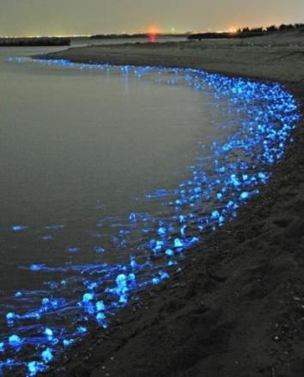
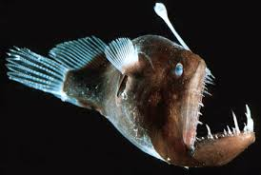
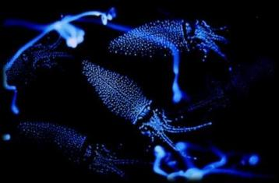
Bioluminescence Adaptation - the emission (releasing) of light from special cells called photophores.
Useful for:
attracting food
confusing predators.

Slide 3
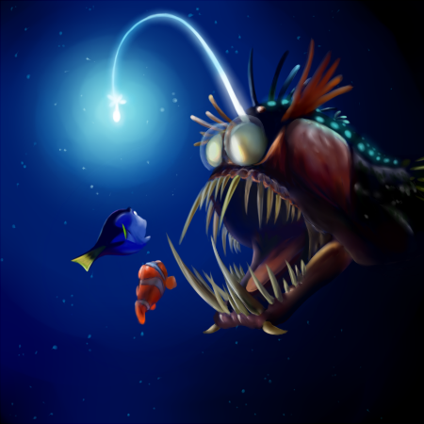
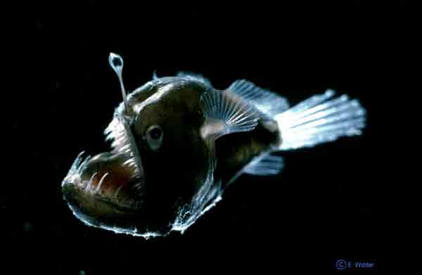
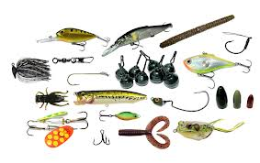
Lures Adaptation
Bioluminescent deep sea creatures use bioluminescent lures for attracting prey.

Slide 4
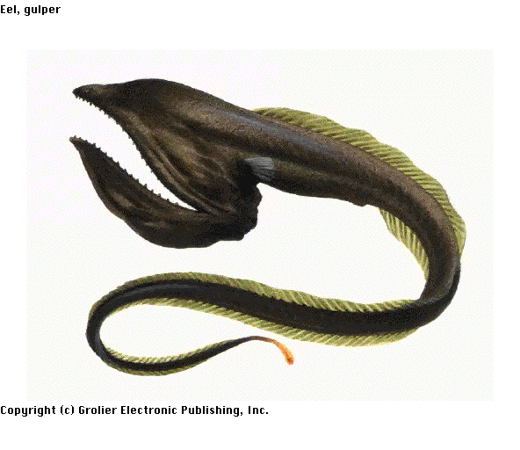
Wide Mouth Adaptation
A wide mouth can also be used like a net to catch many smaller prey at once.
The gulper eel’s mouth is so large that it can swallow organisms much bigger than itself whole. Once swallowed, the gulper eel’s stomach will stretch to fit its meal.

Slide 5
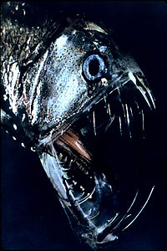
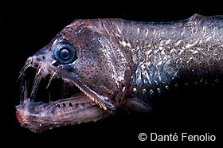
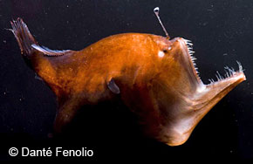
Needle-Like Teeth Adaptation:
Some organisms in the deep ocean have long, needle-like teeth that point inward, keeping prey from being able to escape once caught.
Viper fish and deep sea angler fish
Some fish actually have teeth so long and sharp that they can never close their mouths completely!

Slide 6
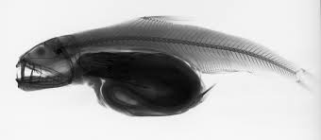
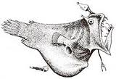
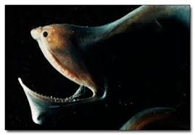
Stretchy Stomachs Adaptations:
Food is scarce, this helps organisms eat lots of food at one time if it becomes available!

Slide 7
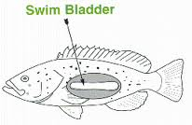
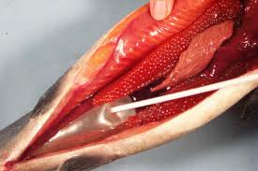
Swim Bladder Adaptation:
Pressures are very high in the deep-sea environment. To adapt, deep sea fish do not have normal bladders. If they do have one, their bladder is filled with lipids (fats) instead of gas. Gases could compress and collapse under the pressure, but the fats will stay solid.
If deep sea organisms are brought to the surface, their bladders may burst because of the change in pressure.

Slide 8
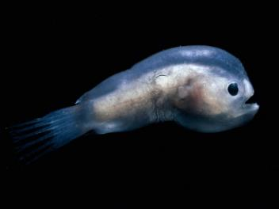
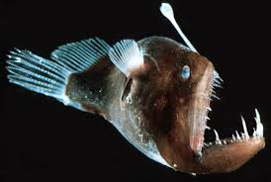
Mating Adaptation:
Mating is particularly difficult in the deep sea, so fish have developed certain adaptations specifically to help carry on their species.
Ex: The deep-sea anglerfish.
The male anglers are small and act as parasites. They attach themselves to the female and fuse into her circulatory system (they share blood). She supports them both while the male is there solely to fertilize the female’s eggs.
Male
Female

